Slide 1

Library Database Anlaysis
Using SQL
Presented By:
K. Shiva Prasad
Batch no: 493

Slide 2
About me:
Background: B.TECH – ECE
Course: Data Analytics (Innomatics Research Labs)
Why Data Analytics : I am interested in Data Analytics because it helps transform data into meaningful insights that support better business decisions.
Linkedin :https://www.linkedin.com/in/kuntimally-shiva-prasad-95740b39a/
Github : https://github.com/k-shiva248

Slide 3
Agenda
Business Problem
Problem Statement
Project Objective
ER Diagram and Schema Explaination
SQL Queries Results
Business Key Insights
Conclusion
Recommendations

Slide 4
Business Problem:
Difficulty in managing large volumes of book records manually.
Lack of real-time information on book availability across branches.
Inefficient tracking of borrowed and returned books.
Errors and duplication in borrower record management.
Challenges in monitoring overdue books and due dates.
Limited reporting and analysis of library usage and inventory.

Slide 5
Problem Statement:
Centralize management of books, authors, publishers, and borrowers in a single database.
Track book availability and copies across multiple library branches.
Maintain accurate borrower records and membership details.
Monitor book issue, return, and due dates efficiently.
Reduce manual errors through automated record management.
Generate reports on book circulation, inventory, and borrower activity.

Slide 6
Project Objective:
The main objective of this project is to design and analyze a Library Management System using SQL to efficiently manage books, authors, publishers, borrowers, library branches, and book loans.
The system aims to automate library operations, maintain accurate records, track book availability across branches, monitor borrowing and return activities, and generate meaningful reports for better decision-making.

Slide 7
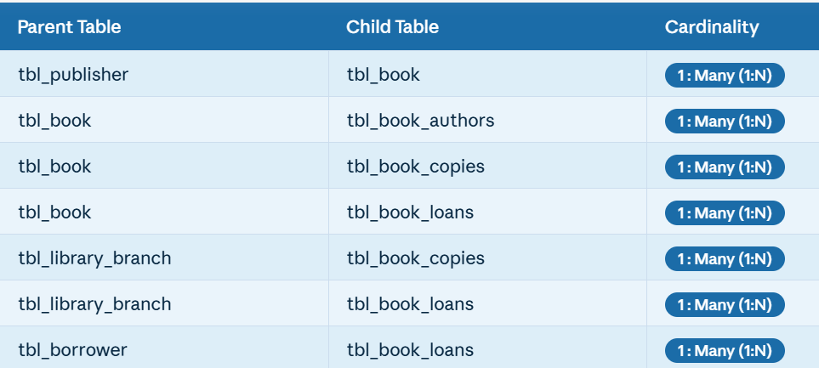
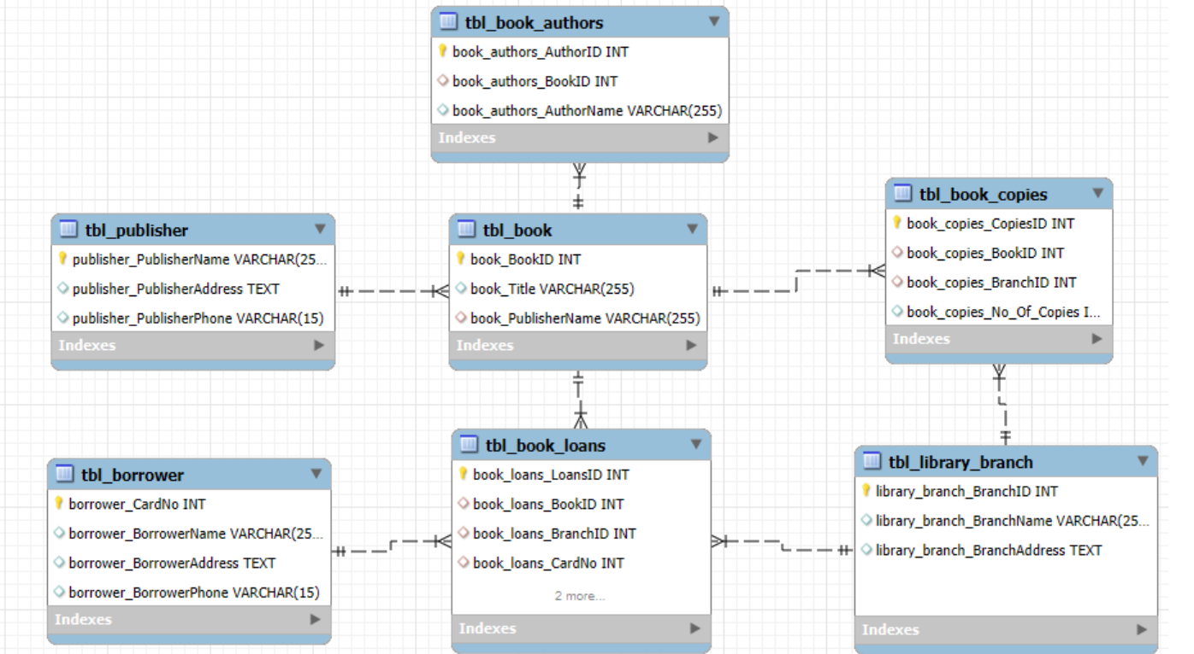
ER DIAGRAM

Slide 8
Schema Explaination:
This schema models a library management system, tracking books, authors, branches, borrowers, loans, publishers, and copies
tbl_book: Stores book details (BookID, Title, PublisherName).
tbl_book_authors: Links books to their authors.
tbl_publisher: Contains publisher contact information.
tbl_library_branch: Lists all library branches.
tbl_borrower: Stores borrower details such as name and contact.
tbl_book_copies: Tracks the number of copies of each book in each branch.
tbl_book_loans: Records when a borrower loans a book from a specific branch.

Slide 9
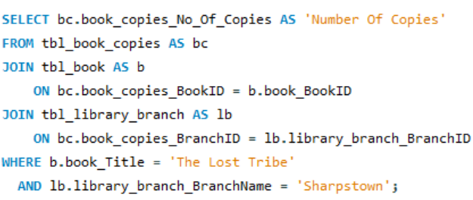

How many copies of the book titled "The Lost Tribe" are owned by the library branch whose name is "Sharpstown"?

Slide 10
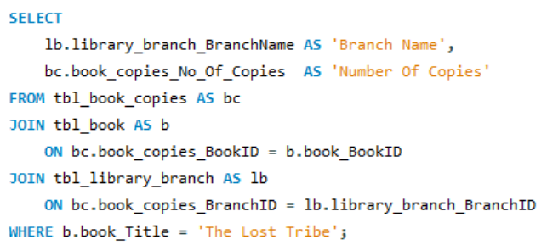
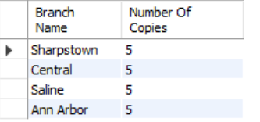
How many copies of the book titled "The Lost Tribe" are owned by each library branch?

Slide 11
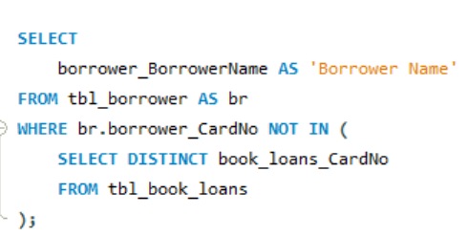

Retrieve the names of all borrowers who do not have any books checked out.

Slide 12
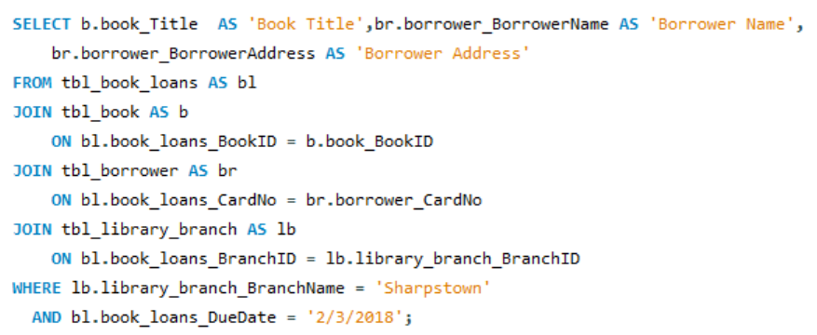
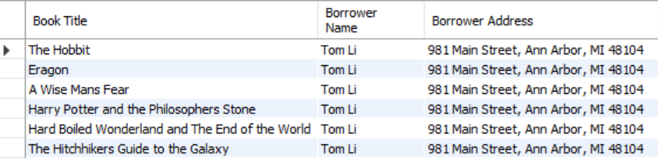
For each book that is loaned out from the "Sharpstown" branch and whose Due Date is 2/3/18, retrieve the book title, the borrower's name, and the borrower's address.

Slide 13
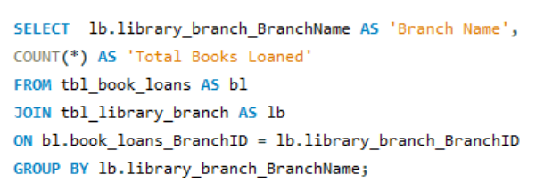
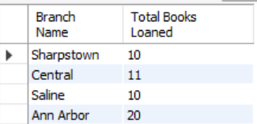
For each library branch, retrieve the branch name and the total number of books loaned out from that branch.

Slide 14

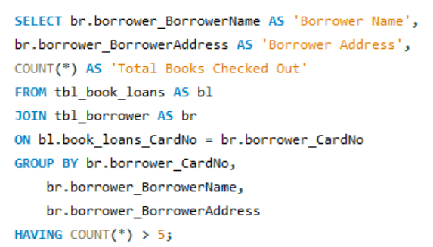
Retrieve the names, addresses, and number of books checked out for all borrowers who have more than five books checked out.

Slide 15
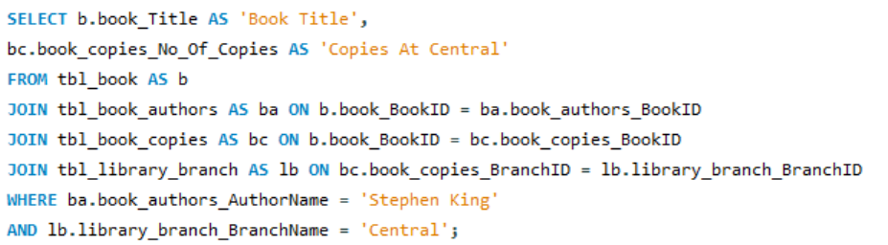

For each book authored by "Stephen King", retrieve the title and the number of copies owned by the library branch whose name is "Central".

Slide 16
Key Insights:
A centralized database significantly improves the efficiency of library operations.
Proper relational database design helps maintain data consistency and reduces redundancy.
Real-time tracking of book inventory improves resource availability and management.
Automated loan and return tracking minimizes manual errors and overdue book issues.
SQL queries enable quick retrieval of information and generation of meaningful reports.
Branch-wise inventory management helps optimize book distribution across libraries.

Slide 17
CONCLUSION:
The Library Management System automates and simplifies library operations.
It efficiently manages books, borrowers, authors, publishers, and branches.
The system improves accuracy by reducing manual record-keeping errors.
It enables effective tracking of book availability, loans, and returns.
SQL-based database management ensures organized storage and quick data retrieval.
Overall, the project enhances library efficiency, resource utilization, and decision-making.

Slide 18
Recommendations:
Implement an automated notification system for overdue and due books.
Add role-based access for librarians, administrators, and borrowers.
Introduce an online book search feature for faster book discovery.
Enable real-time inventory updates across all library branches.
Generate advanced reports and dashboards for better decision-making.
Integrate barcode or QR code scanning for efficient book issue and return processes.

Slide 19


Slide 20

THANK YOU

